Slide 1

Controlling for the general psychopathology factor ‘p’
in genomic research on psychiatric disorders
Wangjingyi Liao¹, Engin Keser¹, Andrea G. Allegrini, Kaili Rimfeld, Robert Plomin² and Margherita Malanchini²
Preregistration
¹ These authors contributed equally
² These authors jointly supervised the work
Notes:
Hello everyone My name is wliao today I'm going to follow up with my colleague Engin's talk on our project controlling further general psychiatric factor P in genomic research on psychiatric disorders

Slide 2
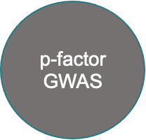
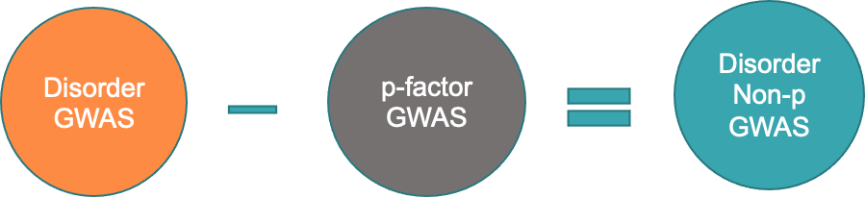
Genome Wide Association Analysis
Notes:
Just a little recap from Engin's talk we used genomic SEM to conduct a common factor gwas from the 11 major psychiatric disorders to extract the genetic effects of p. Then we use gwas by subtraction to remove the P factor from each of the disorder gwass to get the genetic effects that are not captured by p.

Slide 3
Comparing genetic effects on psychiatric disorders before and after residualizing for ‘p’
Downstream Analyses
LD Clumping
Independent significant hits
Risk loci for each disorder that are not captured by p genetics
Gene Level Analysis (MAGMA)
Identify the most relevant genes
Explore gene enrichment
Genetic Correlations
Correlations with external outcomes
Part 2
Notes:
So! We got the summary statistics of the 11 Non-ps, what we are going to do with it? Off course, your first instinct will to explore them in the GWAS downstream analyses. Yes that’s what we did as well. So the aim of my talk is to applying the downstream analysis in our summary statistics and to compare the genetics of psychiatric disorders before and after we residualizing for P.
There are three sections in my downstream analysis: genetic correlation, LD clumping and MAGMA.
We firstly will show your how the psychiatric disorders correlated with external biological and behavioural traits before and after we taking out p.
Then we move to the linkage disequilibrium Clumping results where we identify the independent significant hits and risky loci of the 11 Major psychiatric disorders that are not captured by P.
And last but not least, we moved from the SNP level results a step forward to the gene level analysis using magma where we identifying the most relevant genes to the disorders that are independent of p, we will examine their gene enrichment as well.

Slide 4
Comparing genetic effects on psychiatric disorders before and after residualizing for ‘p’
Downstream Analyses
LD Clumping
Independent significant hits
Risk loci for each disorder that are not captured by p genetics
Gene Level Analysis (MAGMA)
Identify the most relevant genes
Explore gene enrichment
Genetic Correlations
Correlations with external outcomes
Part 2
Notes:
Fistly. The genetic correlation analysis.

Slide 5
Household income
Risky behaviour
Fertility
Health
Psychological
Demographic
Anthropometric
BMI
Birth weight
Height
Cognitive
Personality
Wellbeing
Health
Neighbourhood deprivation
Longevity
Genetic Correlations with external traits using LDSC
Notes:
We used linkage disequilibrium score regression to examine the genetic correlation with external traits. we have four categories.
for the demographic category we investigated some social economic status related traits such household income and neighbourhood deprivation, as well as longevity
The next category is the anthropometric traits including BMI, birth weight and height.
For the health related traits, broadly we are investigating risky behaviour, fertility and health.
finally for the psychological category we investigated the correlation with cognition personality and well-being.

Slide 6
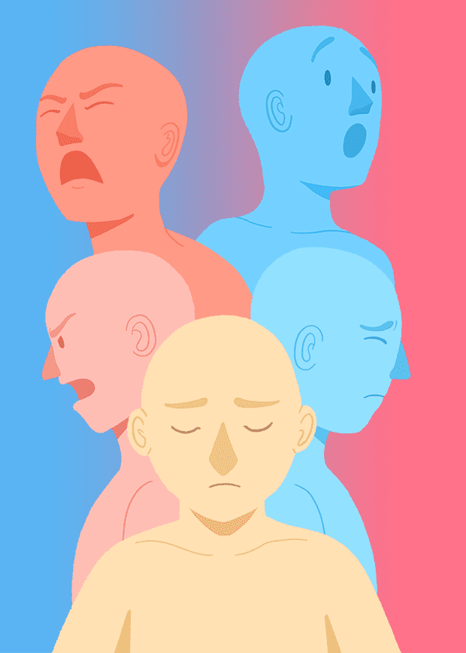
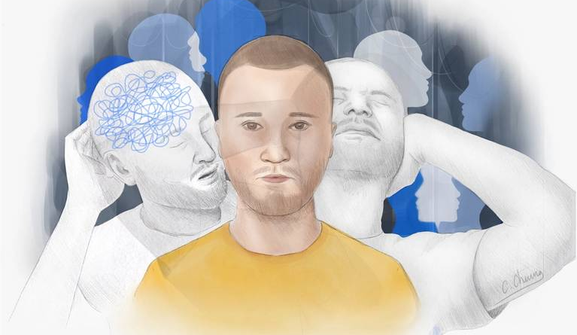

Focus on Schizophrenia and ADHD
Notes:
For the sake of time for today's presentation I will mainly focus on the schizophrenia and adhd results just to show you an example.

Slide 7
Schizophrenia: Correlations with Demographic &
Anthropometric Traits
-1.00
-0.75
-0.50
-0.25
-0.00
0.25
0.50
0.75
1.00
Notes:
Our first example is the schizophrenia result
here are the correlation between schizophrenia and demographic and anthropometric traits before and after controlling for P
the X axis is the correlation scale The Y axis is the name of the external traits.
the orange dot is the schizophrenia after portioning out P. and the green is the original schizophrenis GWAS.
As you can see for those two categories There aren't a lot of differences in the correlations before and after taking out P.
When we take a closer look at the demographic traits. You see that all three traits were associated with schizophrenia original GWAS. This fit the literature that family incomes and social inequality are associated with greater risk of schizophrenia. However by taking out p, we see a reduction in their correlation. This might suggest that p, to some extend ,,is explaining the schizophrenia correlation with demographic traits.
However, those results are really fresh out from he computer. we need to test those difference before drawing any conclusions. (Our next step is to test the significant differences between the correlation results to see that if taking out P significantly changed the relationships between schizophrenia and the demographic outcomes. )

Slide 8
Schizophrenia: Correlations with Health Related Traits
-1.00
-0.75
-0.50
-0.25
-0.00
0.25
0.50
0.75
1.00
Notes:
In terms of schizophrenia correlations with health related treats you can see by taking p, their correlations didn’t change very much, especially for fertility related traits, nothing significantly changed. But there is few exceptions we want to highlight here.
For example, smoking...current evidence suggests that there is a strong association between smoking and SCZ. And our positive correlation between being a ever smoker and schizophrenia supported the conclusion. Yet by taking out p, we see a substantial reduction in correlations. This we think may mean that p was explaining in partly how smoking was correlated with schizophrenia.
We see a similar trend in the risky behaviours, . research have shown risky sexual behaviour and SCZ were associated. And our results showed that Schizophrenia had greater associations with risk behaviour composite and number of sexual partners before taking out p. this Again, might suggest that general psychopathology factor were partially explaining the relationship between schizophrenia and risk behaviours.

Slide 9
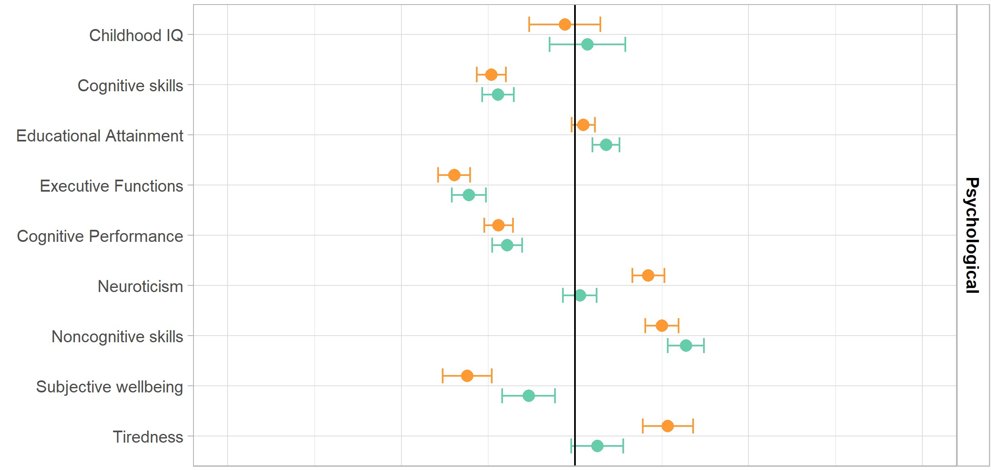
Schizophrenia: Correlations with Psychological Traits
-1.00
-0.75
-0.50
-0.25
-0.00
0.25
0.50
0.75
1.00
Notes:
Finally for the psychological traits, What was surprising is that a lot of the cognitive traits was not influenced by taking out P, such as cognitive performance, cognitive and noncognitive skills.
We know that there is a negative association between SCZ and some of the cognitive traits; however, after taking out p, there didn't seem to be a change. Suggesting their association may not be explained by p!
However there are few interesting results showed mixed results that taking out p have strength or weaken their associations. For example, the educational attainment was positively but not significantly correlation with schizophrenia. But if you see the Schizophrenia Non-p, the association with EA actually increased! After taking out p, schizophrenia and education attainment is now positively correlated. This suggest p might be masking the association between schizophrenia and education outcomes. (Bansal et al 2018 also found a positive rgs between scz and EA, and they think several genes seem to have pleiotropic effects on EA and SZ)
Our results also showed that by taking out p, the neurocicism, subjective wellbeing and tiredness, have much less correlation with schizophrenia. Especially for neuroticism and tiredness, schizophrenia non-p is no longer associated with those two traits.
These patterns of change suggest that p might be clouding and masking the true association between traits and schizophrenia.

Slide 10
ADHD: Correlations with Demographic & Anthropometric Traits
-1.00
-0.75
-0.50
-0.25
-0.00
0.25
0.50
0.75
1.00
Notes:
Now let's move to the ADHD result for genetic correlations. surprisingly there aren't any changes between ADHD and demographic and anthropometric traits. suggesting P didn't explain the association between ADHD and those traits.

Slide 11
ADHD: Correlations with health related traits
-1.00
-0.75
-0.50
-0.25
-0.00
0.25
0.50
0.75
1.00
Notes:
For the health related traits category, surprisingly really nothing was changed in this category
Unlike schizophrenia we see changes in the risky behaviours, taking out p doesn’t seem to influence the association between adhd and risky behaviours as all.
given the profound amount of literature between ADHD and risk behaviours (and comparing with other psychiatric conditions) our results highlighted their relationship was not explained by the general psychopathology factor, but maybe something more fundamental and adhd specific.

Slide 12
ADHD: Correlations with psychological traits
-1.00
-0.75
-0.50
-0.25
-0.00
0.25
0.50
0.75
1.00
Notes:
When it comes to psychological traits, again we see taking out P did not change ADHD's associations with cognitive traits, but this time, including education attainment. Given the profound correlation between ADHD and cognitive outcomes, again we think adhd and cognitive traits their correlation was not explained by the p.
On the other hand, Similar with schizophrenia, ADHD now show much less association with neuroticism, subject wellbeing, and tiredness, after taking out p than before.
(Again, those might show P had masking the genetic relationship between ADHD and those traits. )

Slide 13
Comparing genetic effects on psychiatric disorders before and after residualizing for ‘p’
Downstream Analyses
LD Clumping
Independent significant hits
Risk loci for each disorder that are not captured by p genetics
Gene Level Analysis (MAGMA)
Identify the most relevant genes
Explore gene enrichment
Genetic Correlations
Correlations with external outcomes
Part 2
Notes:
That is the end of the correlation results. Overall, our findings highlighted that, by taking out p, we might begin uncovering the true associations between schizophrenia and those traits, independent of a general factor.
Now let’s move to the second part of my talk, the independent hit results.

Slide 14
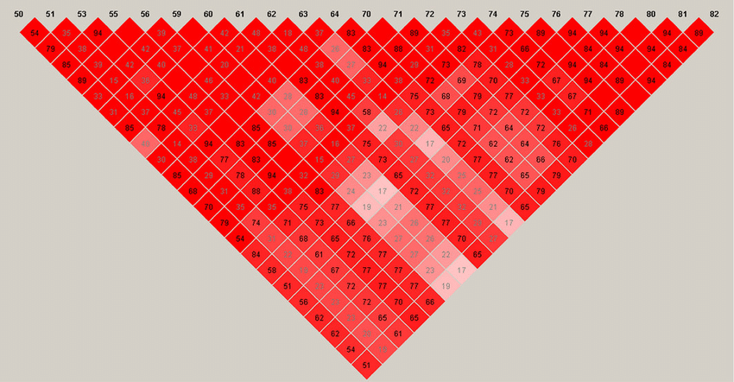
Uses LD information between genetic markers to prioritize lead SNPs contributing to GWAS signals.
Allows us to identify a subset of independent SNPs that are most relevant to each psychiatric disorder independent of ‘p’
Linkage Disequilibrium (LD) Clumping
Notes:
For this part of the presentation, We used the LD clumping to analyse the non-p summary statistics.
I am sure you all have known what LD clumping is, but just a little reminder to people who might not be familiar with genetic researches.
LD clumping is a method that use LD information between genetic markers to prioritise lead snps contributing to the GWAS signals.
By using LD clumping, researchers can reduce redundancy, focus on the most relevant SNPs within LD groups, and potentially identify causal variants associated with the trait or disease.
Thus it allows us to identify a subset of independent snps that are most relevant to each psychiatric disorder independent of P.

Slide 15
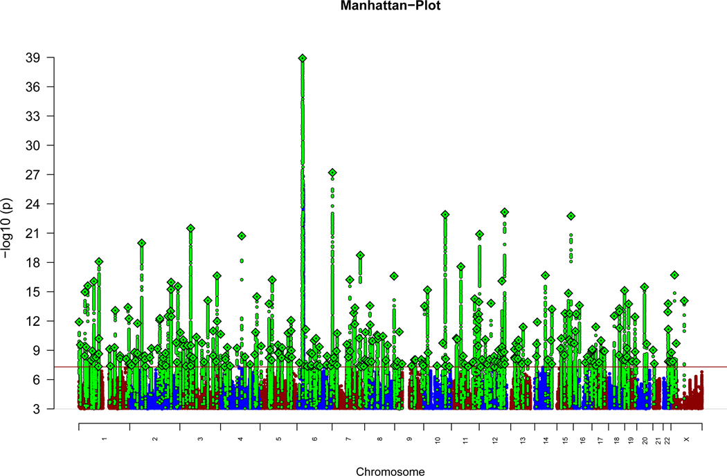
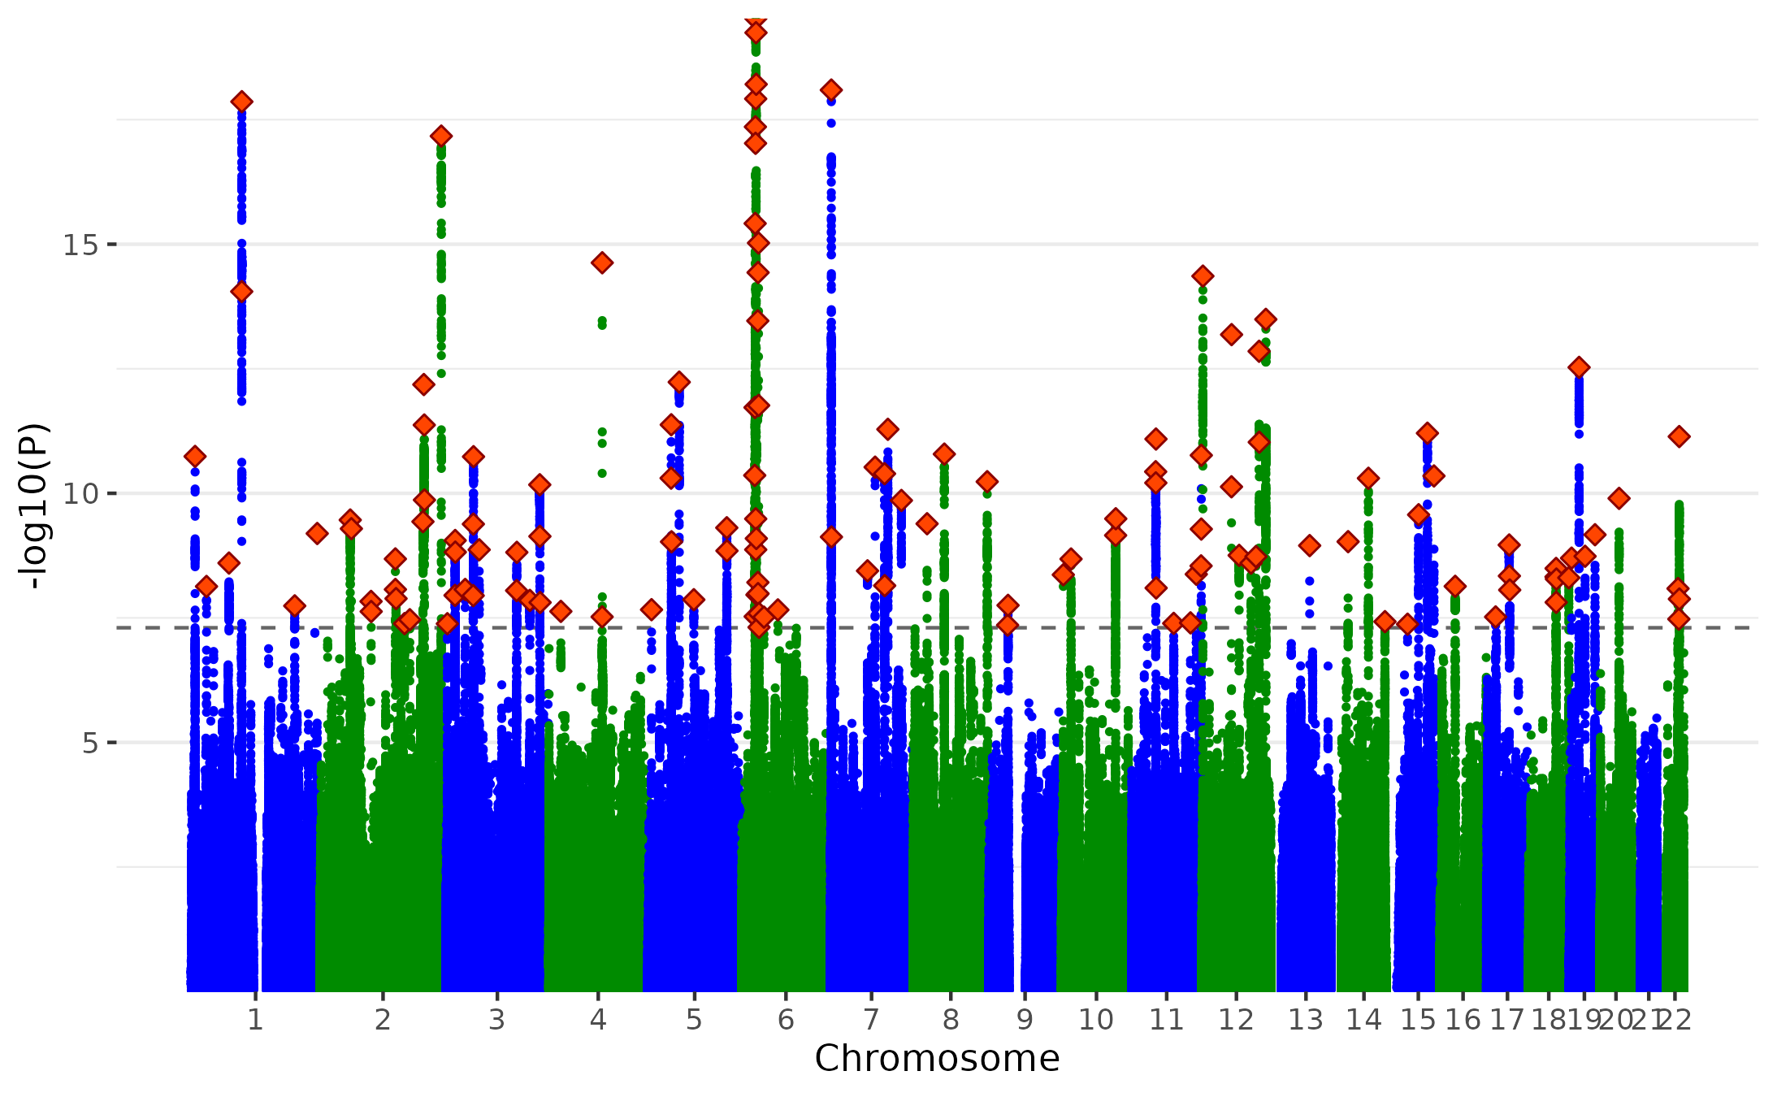
Results: Comparing SCZ original GWAS with SCZ ‘non-p’ GWAS
342 independent genome-wide significant hits
99 independent genome-wide significant hits
rs13195636
Trubetskoy et al. (2022) Nature Genetics
Notes:
Firstly the schizophrenia results
here are the results of the independent significant hits of schizophrenia, visualized in the Manhattan plot. on the right hand side is our non-p, and the left hand side is the original gwas. as you might expect when we taking out P there is a general reduction in the p values in the gwas signals.
In the original GWAS they totally found over 300 independent hits, but in our cases, we found 99.
As you can see the most significant hits in the original gwas is also the most significant one in our GWAS, the rs13195636.
But there are hits which are different in those two Manhattan plots today I will show in an example in chromosome 2.

Slide 16
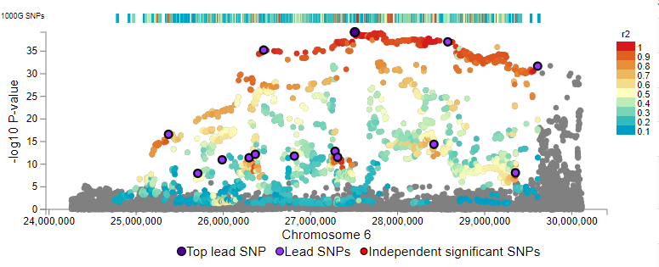
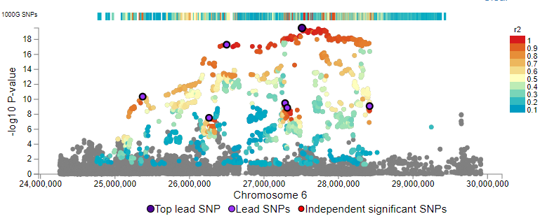
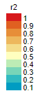
Results: SCZ original and SCZ ‘non-p’ risk loci
Linkage Disequilibrium (LD) Clumping
rs13195636
The most significant risk loci of Trubetskoy et al. (2022) (index SNP rs13195636)
Also the most significant risk loci of Schizophrenia ‘non-p’ (index SNP rs13195636)
Notes:
One interesting loci is that the highest peak in the original gwas. it remained the highest peak in the non-p summary statistics. Here are the locus zoom plot for the same region before and after taking out p.
Again, right is our non-p gwas, left is the original one. they are remarkably similar in fact we are replicating most of the original results in this loci and we have the same index SNP for this region. But our non-p has lower p values as expected.

Slide 17
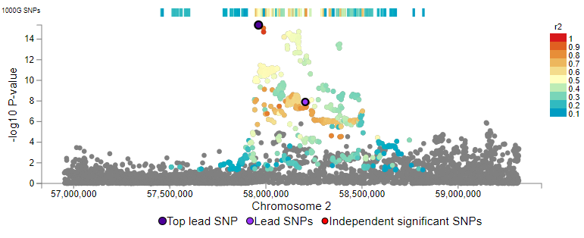
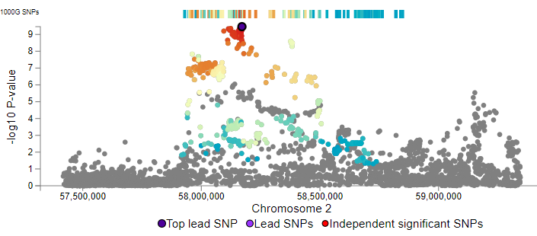
Results: SCZ original and SCZ ‘non-p’ risk loci
Linkage Disequilibrium (LD) Clumping
rs13011472
rs1518393
The risk loci in chromosome 2 from the original schizophrenia GWAS (index SNP rs13011472)
The risk loci in chromosome 2 from schizophrenia
‘non-p’ (index SNP rs1518393)
Notes:
Here are the locus zoom plot of the risk loci in chromosome 2. left is the original schizophrenia GWAS and right is our schizophrenia Non-p GWA. Just a note because those results are very hot results we just got this week. those two figures are in slightly different scales. But the key point is that the independent SNP we got is different from the original one

Slide 18
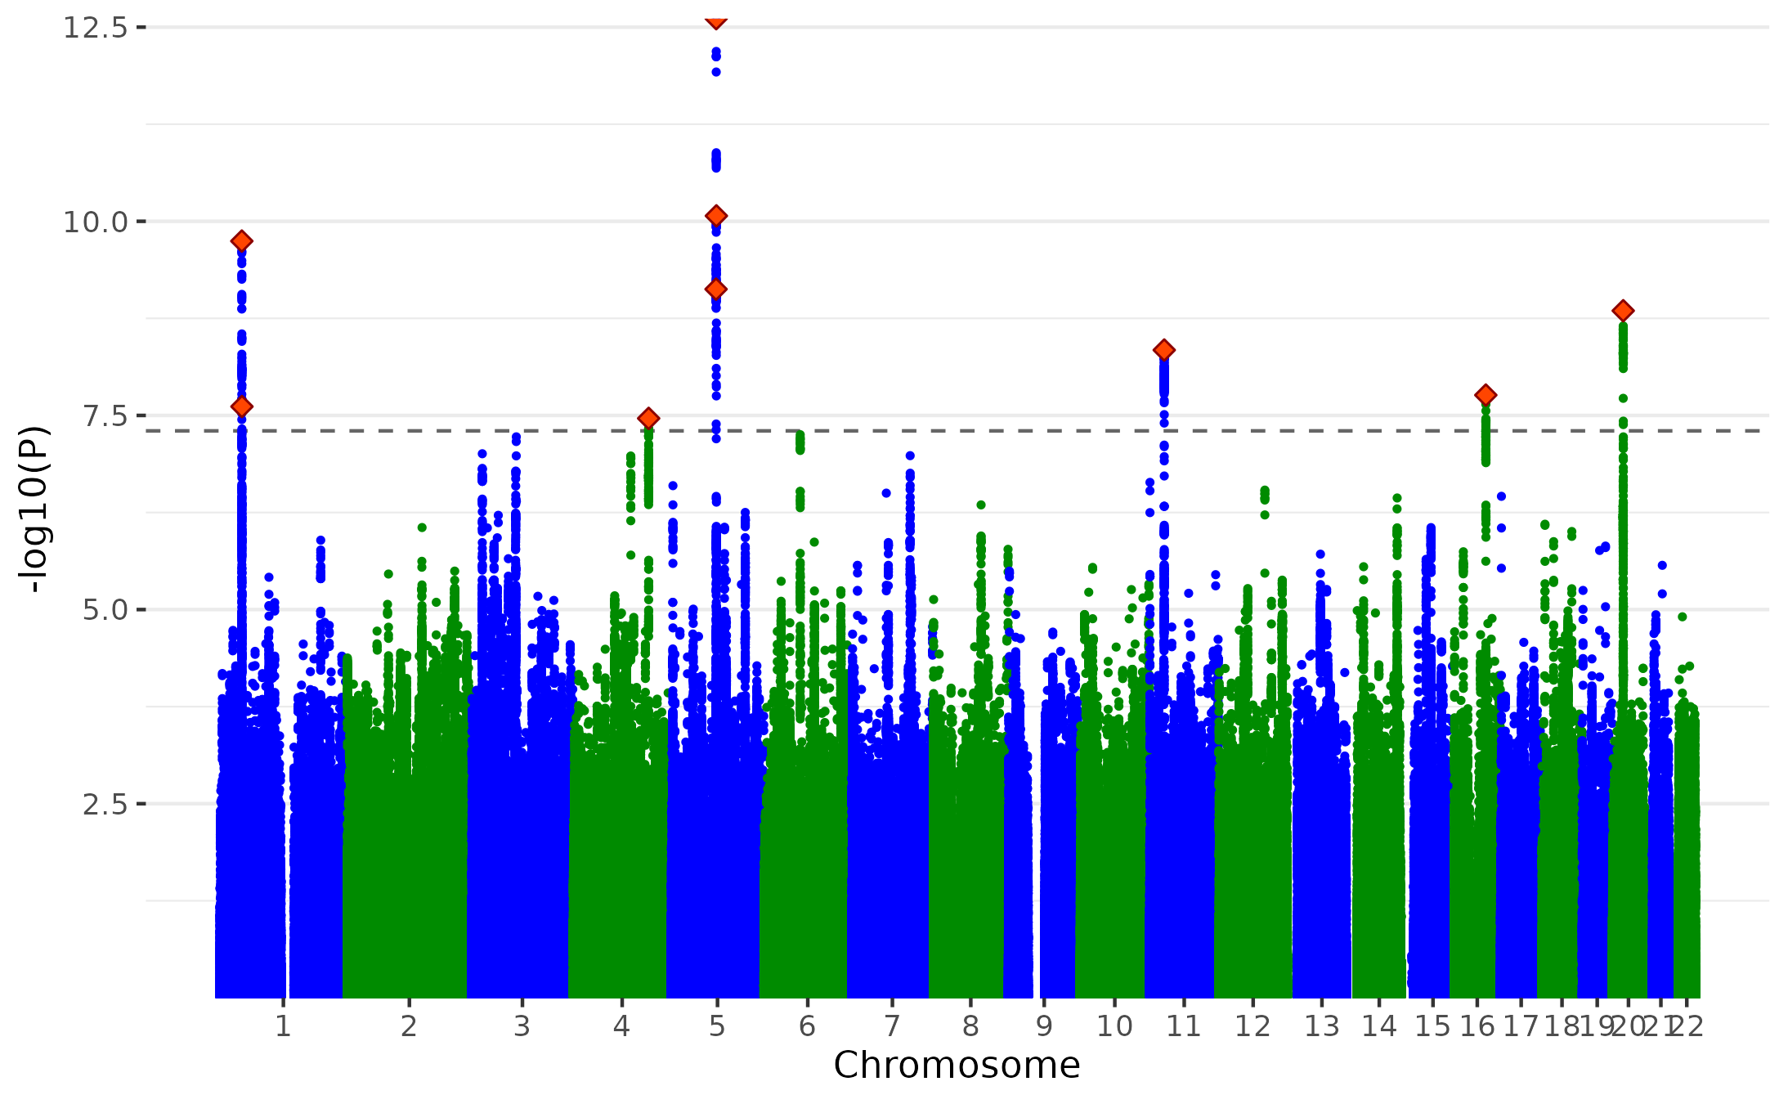
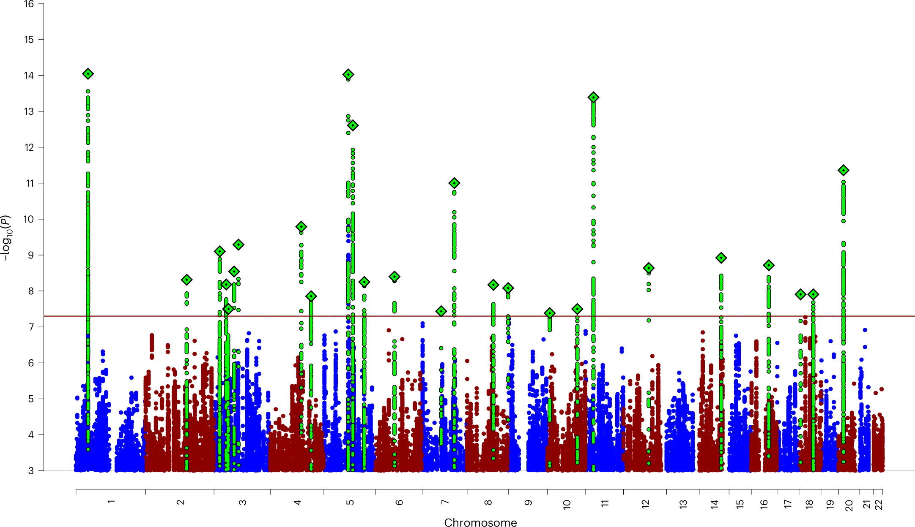
Results: Comparing ADHD original GWAS with ADHD ‘non-p’ GWAS
9
independent significant hits
32
independent significant hits
rs4916723
rs549845
rs7206338
rs1162202
(Demontis et al., 2023)
Notes:
In terms of the ADHD results
After taking out of pAgain we have a general reduction in the p values and we find nine independent significant hits in the ADHD non-p summary statistics.
interestingly we are now getting different the most significant loci before an after taking out the P. For the original gwas the highest hite was in chromosome 1 (as indicated by the arrow), while the peak in the adhd non-p is in chromosome 5.
We found one different loci in the adhd non-p comparing with the original, in chromosome 16.

Slide 19
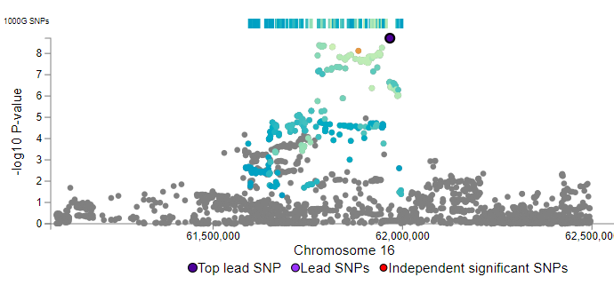
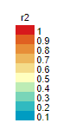
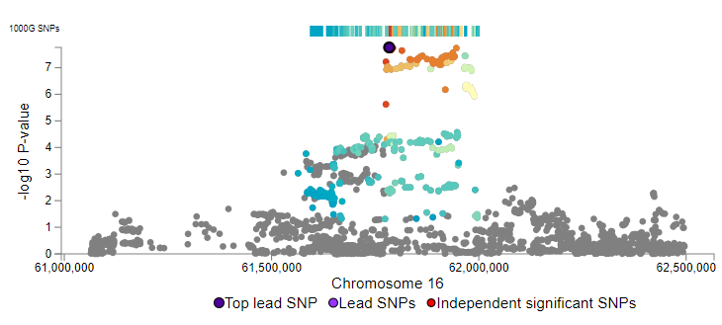
Results: ADHD original and ‘non-p’ risk loci
Linkage Disequilibrium (LD) Clumping
rs1162202
rs7206338
The chromosome 16 risk loci (index SNP rs1162202) of ADHD Original
The chromosome 16 risk loci (index SNP rs7206338) of ADHD ‘non-p’
Notes:
in the chromosome 16 hit,. as you can see we have identified a different independent hit in this region.
Overall those novel independent hits might suggest that by taking out p we are uncovering some genetic effects that might be masked by p (again, is it what it means???).

Slide 20
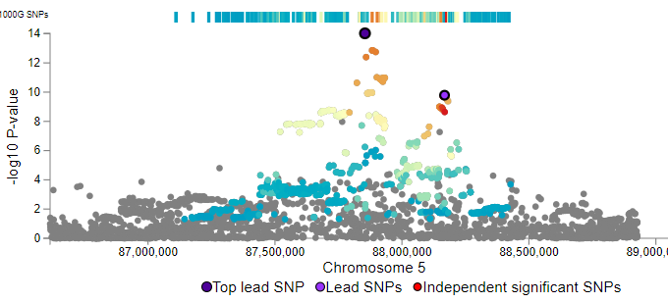
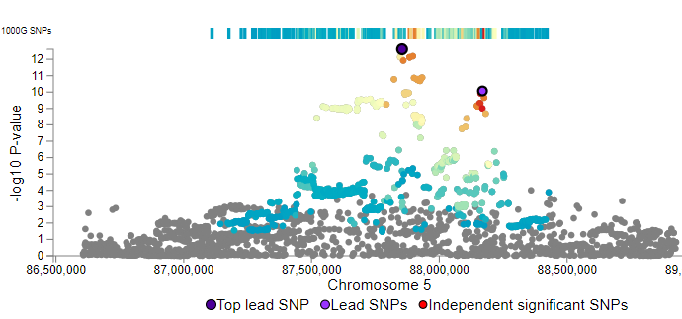
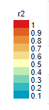
Results: ADHD original and ‘non-p’ risk loci
rs4916723
Linkage Disequilibrium (LD) Clumping
The risk loci in chromosome 5 from ADHD Original Demontis et al. (2023) (index SNP rs4916723)
The most significant risk loci in ADHD ‘non-p’
(index SNP rs4916723)
Notes:
Let's take closer look of the most significant risk loci of ADHD non-p, and we are comparing it to the same region form the original ADHD gwas. As you can see that for this loci we are replicating the significant independent hits.

Slide 21
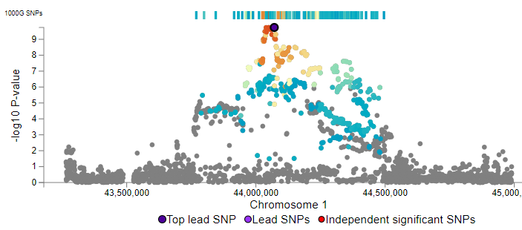
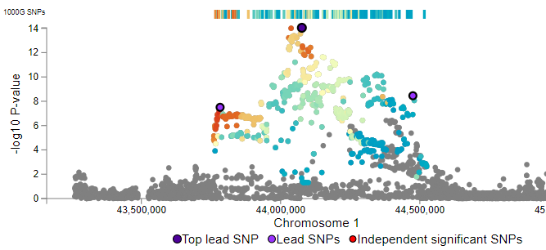
Results: ADHD original and ‘non-p’ risk loci
Linkage Disequilibrium (LD) Clumping
rs631248
rs549845
The most significant risk loci in ADHD original GWAS
(index SNP rs549845)
The risk loci in Chromosome 1 of ADHD ‘non-p’
(index SNP rs631248)
Notes:
But in terms of the most significant risk loci in the ADHD original gwas, we can see that only 1 significant independent hits were identified in the Non-p. this might suggest we are limited by the power to detect those signals.

Slide 22
Comparing genetic effects on psychiatric disorders before and after residualizing for ‘p’
Downstream Analyses
LD Clumping
Independent significant hits
Risk loci for each disorder that are not captured by p genetics
Gene Level Analysis (MAGMA)
Identify the most relevant genes
Explore gene enrichment
Genetic Correlations
Correlations with external outcomes
Part 2
Notes:
Finally, let's move to the last part of the talk, the gene-level analysis,

Slide 23
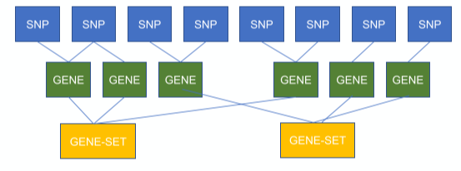
MAGMA – Multi-marker Analysis of GenoMic Annotation
GWAS SNP signals were aggregated to gene level statistics by incorporating LD between SNPs
Three steps included
Gene Level Analyses
1. Map SNPs to genes
2. Gene P values &
Gene-Gene Correlation
3. Gene-set associations
Notes:
We used MAGMA, the multi-marker analysis of genomic annotation to aggregate the GWAS SNP signals to the gene signals by incorporating LD between SNPs.
For people who are less familiar with MAGMA, basically it will first map the SNP to the nearby genes and compute the gene level statistics, gene p values, and calculate statistically how how the genes associated with the phenotypes.
And with the gene level statistics, we can now calculate whether or not particular sets of genes are associated with the phenotype.
Less explanation, Robert says to spend less time explaining this slide, are we talking about gene sets or genes in enrichment???
Stage 1: ANNOTATION Annotating SNPs from GWAS data to genes: MAGMA assigns a SNP to a gene if it is within a defined window around the gene, 35kb upstream, 10kb downstream, SNPs may be assigned to more than one gene as gene position overlapping
Stage 2: GENE ANALYSIS Generating gene statistics: Following annotation, we can then generate statistics on how associated each gene is with
our GWAS trait of interest, Based on a multiple principle components linear regression model, using an F-test to compute each gene p-value, Requires a population reference panel (e.g. 1000 Genomes) to account for linkage
disequilibrium
Stage 3: GENE-SET ANALYSIS Generating gene-set statistics: With our gene p-values, we can now calculate whether or not particular sets of genes are associated with the GWAS trait of interest, Gene-sets which are enriched for association can then be taken forward for additional analysis, e.g. functional
annotation

Slide 24
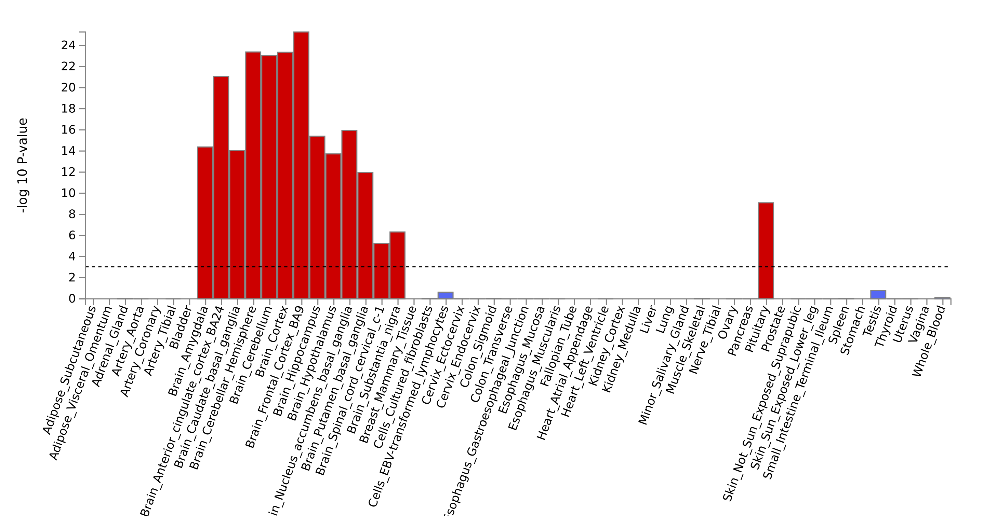
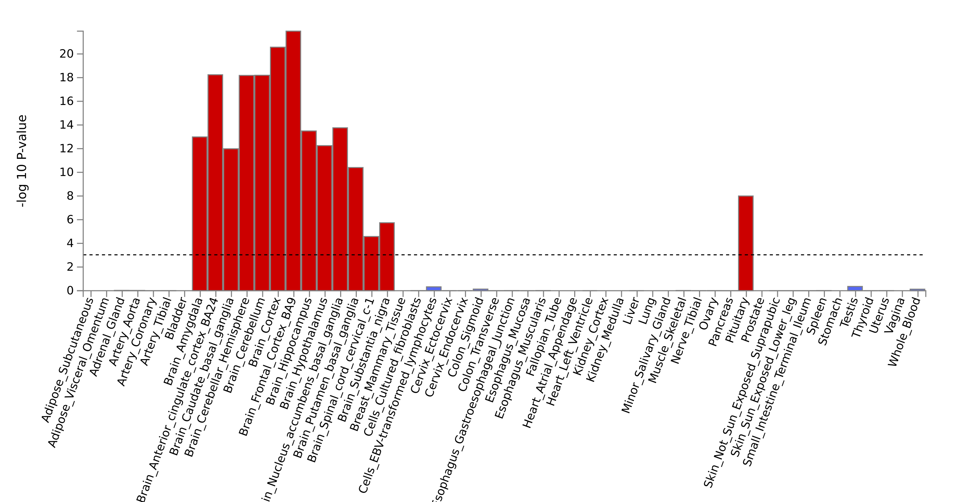
Results:
Schizophrenia original and Schizophrenia ‘non-p’ Tissue Type Enrichment
Schizophrenia Original
GWAS
Mapped Genes
659
137
28
83
6
3
Schizophrenia Non-p GWAS
GTEx v8 53 Tissue Types
Significant Enrichment
Not significant enrichment
Notes:
Here I am presenting the gene tissue type enrichment results comparing the original and non-p schizophrenia summary statistics. The x axis are the tissue types and y is the p values. Upper is the original one and bottom is the non-p results.
The red bar is the significant enrichment regions after multiple comparison correction. The blue is the not significantly enriched regions.
We can see all brain regions were enriched in the original GWAS were also enriched in the schizophrenia non-p, with a reduction in the p values but very similar trend.
Suggesting taking out p was not massively influencing the enrichment results for schizophrenia.

Slide 25
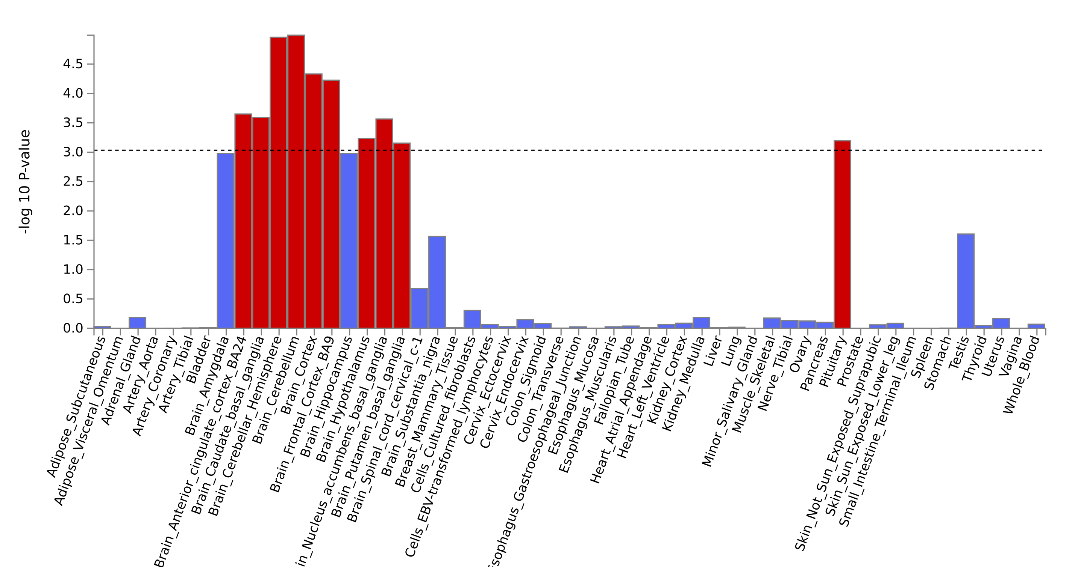
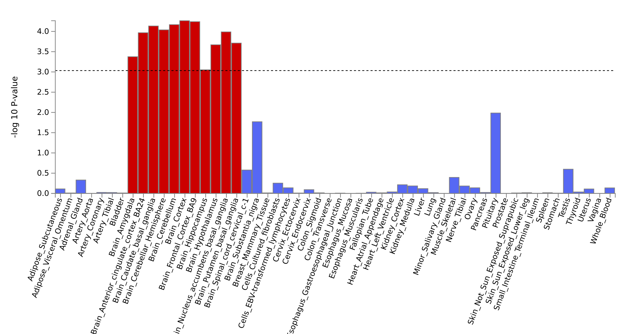
Results:
ADHD original and ADHD ‘non-p’ Tissue Type Enrichment
ADHD original GWAS
hemisphere
cerebellum
hippocampus
amygdala
pituitary
Mapped Genes
659
137
28
83
6
3
cortex
Frontal cortex
amygdala
hippocampus
ADHD Non-p GWAS
GTEx v8 53 Tissue Types
pituitary
Significant Enrichment
Not significant enrichment
Notes:
For adhd, all brain regions enriched in the original GWAS were also enriched in the ADHD non-p, except for the pituitary.
however we found that the most enriched brain regions have changed from Hemisphere and cerebellum to brain cortex.
The amygdala and hippocampus which weren't associated with the original ADHD gwas, now become significant enriched after taking out p.
though need further investigation and tons of sensitivity analysis, we results suggests that taking out p could have the potential to help us better understand the disorders’ biology.

Slide 26
Genetic Correlations
Similar patterns for demographic and anthropometric traits
Differences for health and psychological traits
LD Clumping
99 hits for Schizophrenia
9 hits for ADHD
Gene Level Analysis (MAGMA)
Similar brain regions for Schizophrenia
Some difference for ADHD
Summary
Genetic effects associated with individual psychiatric disorders that's independent of ’p’
No major changes in SNP heritabilities
Changes in genetic corelations between disorders
Non-p summary statistics in downstream analysis
Changes in genetic correlations with external traits
LD clumping identified (novel) independent significant hits
Changes in patterns of enrichment in the brain
Notes:
So, to summarize, in the first part of the talk Engin presented, we conducted a GWAS of disorder-specific genetic risk for 11 major psychiatric disorders using Gwas-by-subtraction. By examing the LDSC SNP heritability and genetic correlation, we found surprisingly little reduction in the heritability and very interesting changes in correlation between the disorders, that some are reduced, some are stronger, and some are even reversed.
We then used the summary statistics in the downstream analyses. We specifically looked at the genetic correlations between SCZ and ADHD and external traits, and compared these to the uncorrected GWASs. Results showed very similar patterns before and after portioning out p, but there were some interesting results as well.
we see a few changes (increased and decreased) in genetic correlation mainly in the health and psychological categories, but less in the demographic and anthropometric traits.
Ld clumping have helped us to identify 99 independent hits associated with schizophrenia independent of p, and 9 hits in ADHD.
In the MAGMA, we see interesting changes in the gene enrichment results for ADHD. two region become enriched, and one no longer enriched.

Slide 27
Controlling for p may help with exploring the aetiology of the psychiatric conditions.
Psychiatric research might consider control for p depending on the research interest.
Discussion
More powerful, cross-ancestry and publicly available GWASs are required.
Notes:
(Mention the freshness of the results here, but the key points is )
Overall our results suggested that although there are no dramatic differences, but there are some differences suggesting partitioning out p might change the picture of disorders
Future research on disorder-specific genetic influences might be profitable, and psychiatric research should might consider control for p to avoid capture effects that are more general than specific to the disorders.
The limitation of our study is the quality of the GWAS. We need more poweful, cross-ancestry and PUBLICLY AVALIABLE gwas are need to better estimate the p and non-p genetic effects.

Slide 28

Next Steps
Just a beginning ……
Investigate risk loci further
Functional analysis of the Non-ps
Summary statistics will be freely available
Notes:
Today’s presentations were just the beginning of our analysis and the beginning of explore the genetic effects of psychiatric disorders independent of p.
Our next step is to take a closer look at the risk loci of the Non-ps for all the 11 major psychiatric disorders.
We will also conduct functional pathway analysis in the summary statistics to further explore the biological underpinnings of the disorders.
Our results were very early stage, we will run tongs of sensitivity analysis to test for the robustness of our results. and then we will made our summary statistics publicly available to be freely used in research.

Slide 29








Thank you
Engin Keser
Margherita Malanchini
Robert Plomin
Andrea Allegrini
Kaili Rimfeld
Members of the CoDE Lab
Notes:
I want to say special thanks to my dear colleague Engin Keser for her help and support along the way.
And thanks my supervisor margherita and Robert for their support and guideness.

Slide 30

Notes:
And ofc all member of our lab. Thank you all for all the support and inspirations.

Slide 31
Thank you for listening
Notes:
Consider to be deleted

Slide 32

Additional Slides

Slide 33
Non-Ps | Number of Independent hits | Associated Loci
SCZ | 99 | 82
BIP | 23 | 21
ADHD | 7 | 6
AN | 3 | 2
ALCH | 2 | 2
ASD | 1 | 1
*Anxiety, OCD, PTSD and TS Non-Ps has no significant hits
Results: Independent Hits of the Non-Ps
Independent hits were identified within a 250kb window, r2 < 0.1, p < 5x10-8
Genes were mapped based on physical position 35kb upstream, 10kb downstream.
Notes:
Specify that it's MAGMA used in FUMA
Get rid of this result

Slide 34
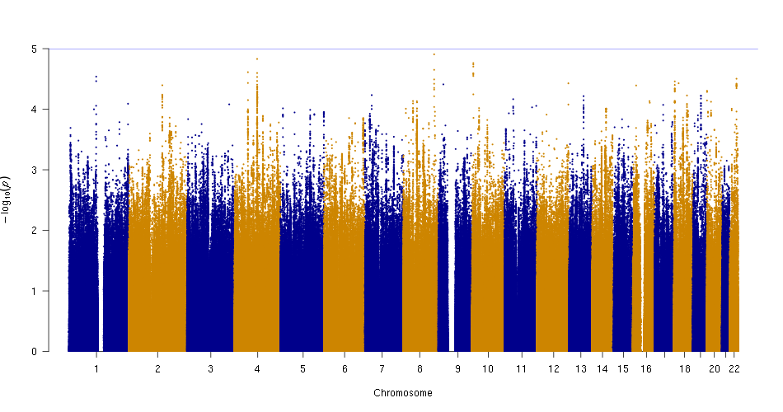
OCD Genetic Correlations

Slide 35
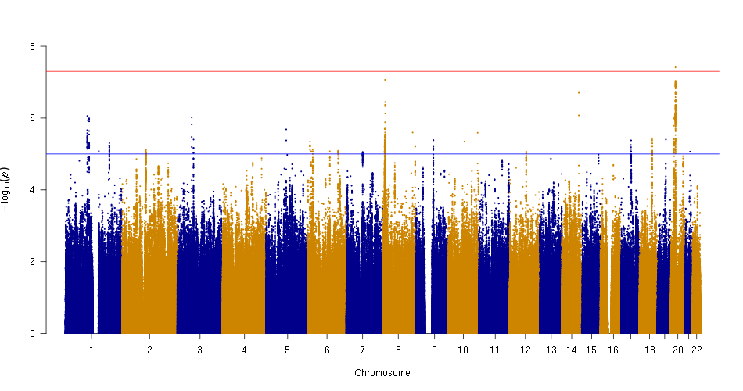
ASD Genetic Correlations

Slide 36
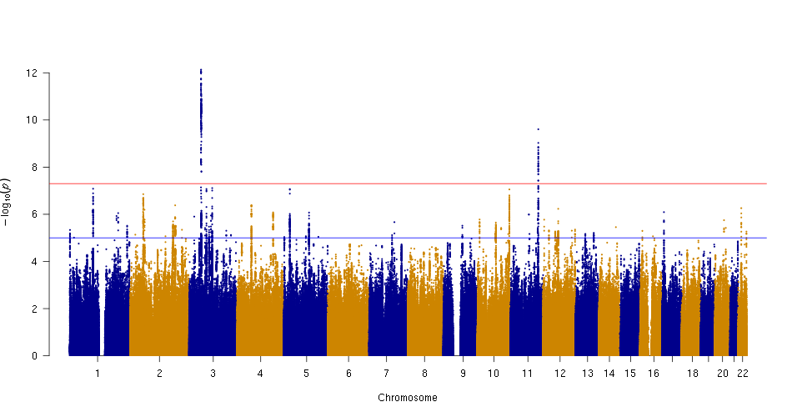
AN Genetic Correlations

Slide 37
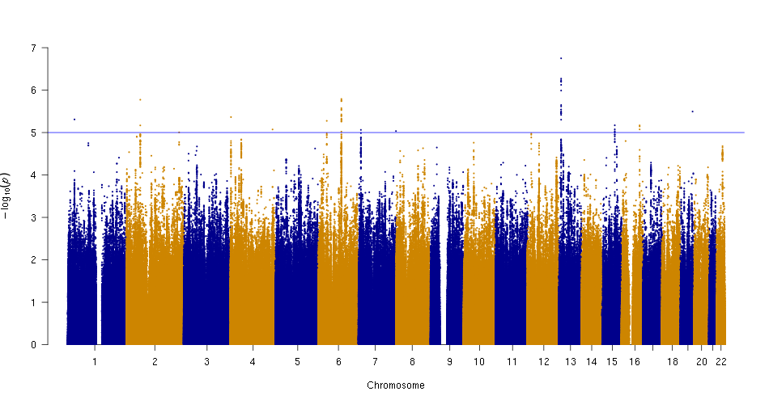
TS Genetic Correlations

Slide 38
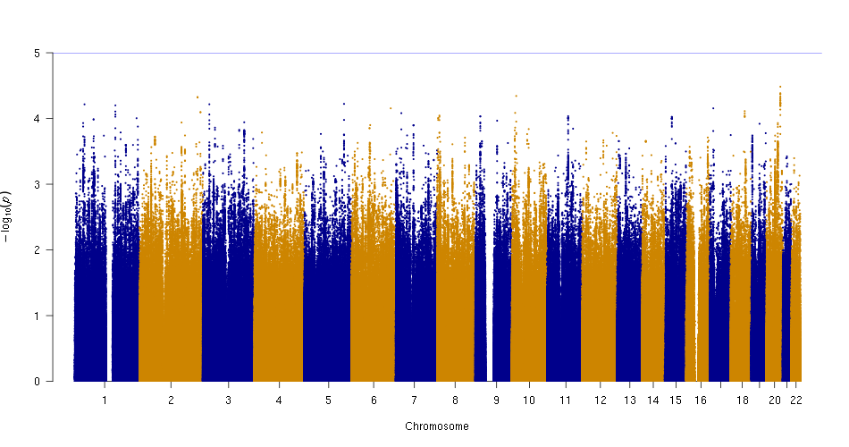
PTSD Genetic Correlations

Slide 39
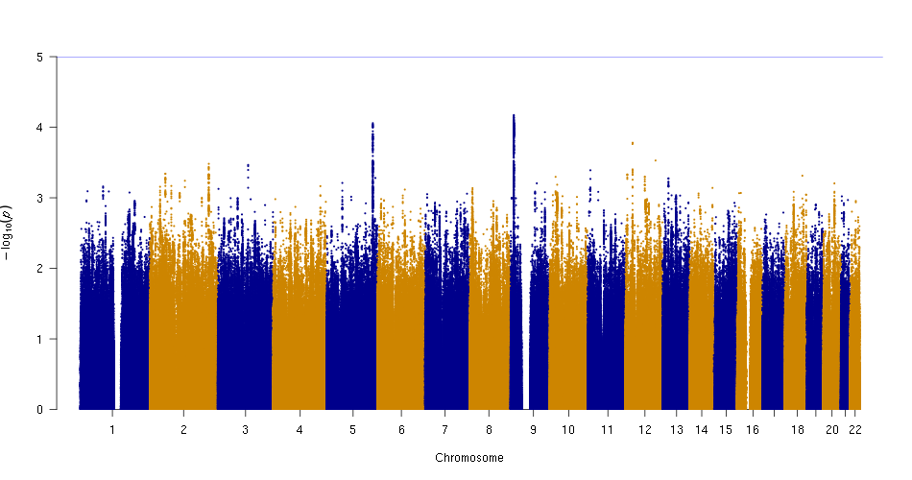
ANX Genetic correlations

Slide 40
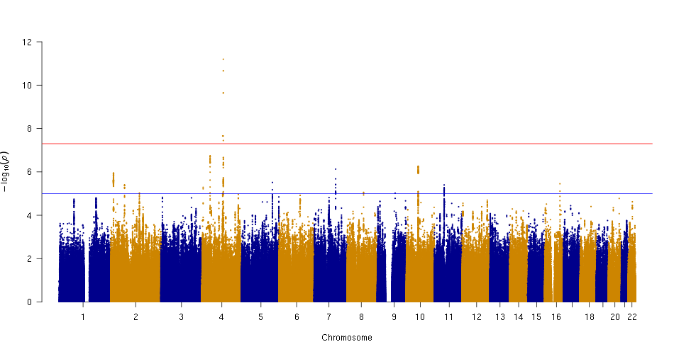
ALCH Genetic Correlations

Slide 41
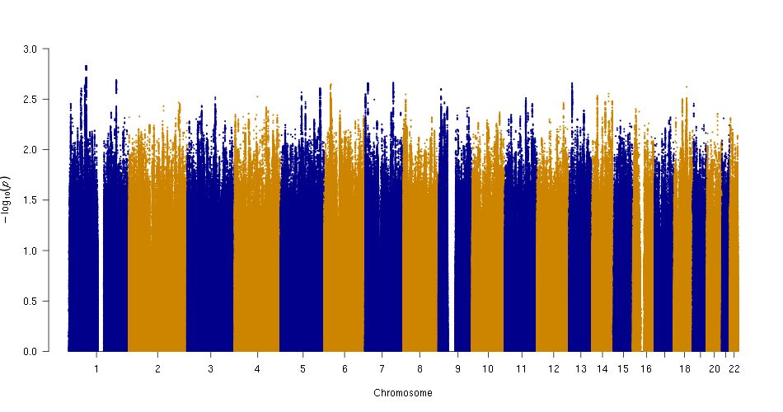
MDD Genetic Correlations

Slide 42
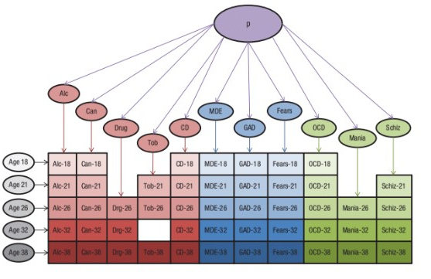
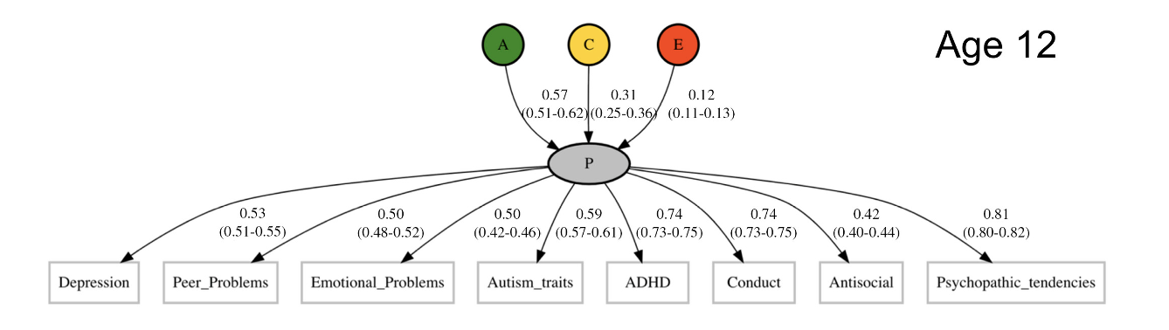
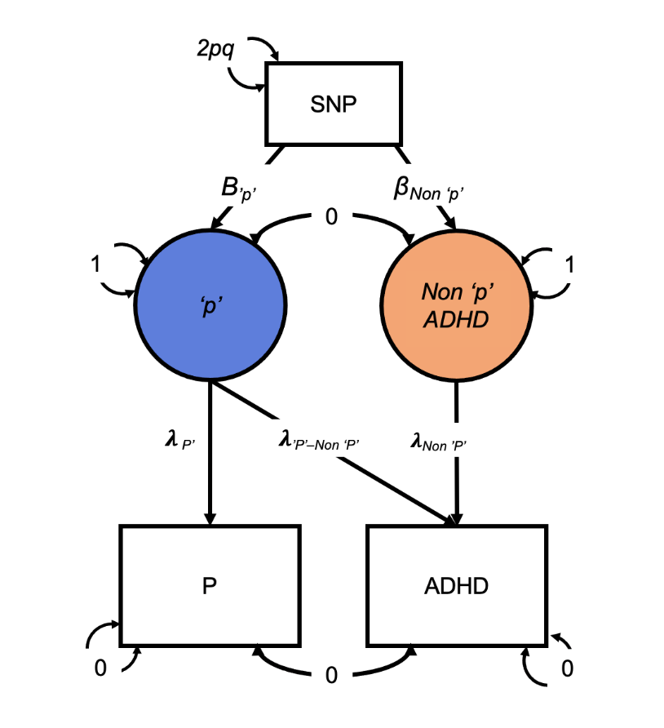
General psychopathology factor P underlined
The need to study disease-specific genetic risk independent of p
Gene underpinning of the P
Recap of Part 1 - Background
Caspi et al., 2014
Allegrini et al., 2019

Slide 43
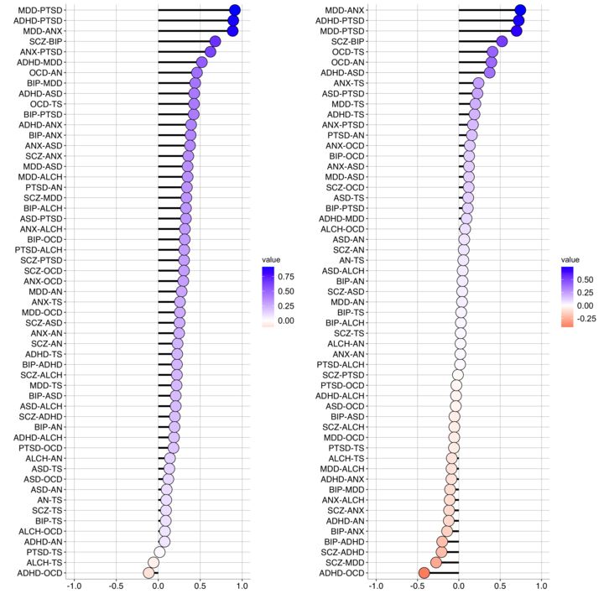
Recap of Part 1 – SNP heritability and Genetic Correlation
Results
SNP heritability of non-p factor change in both direction compared to the h2 of uncorrected disorders.
Three different patterns of change in genetic correlations between the disorders: small reduction, substantial reduction, and reversed.

Slide 44
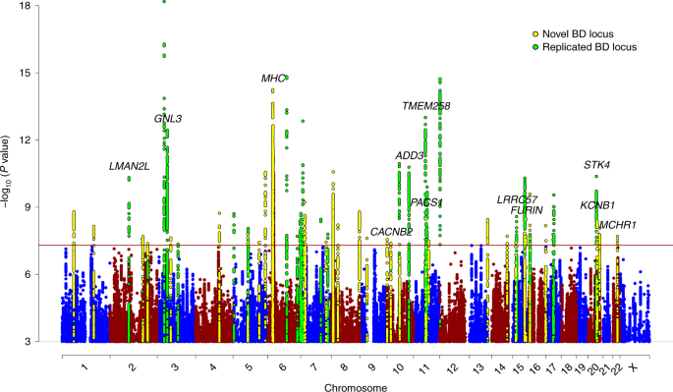
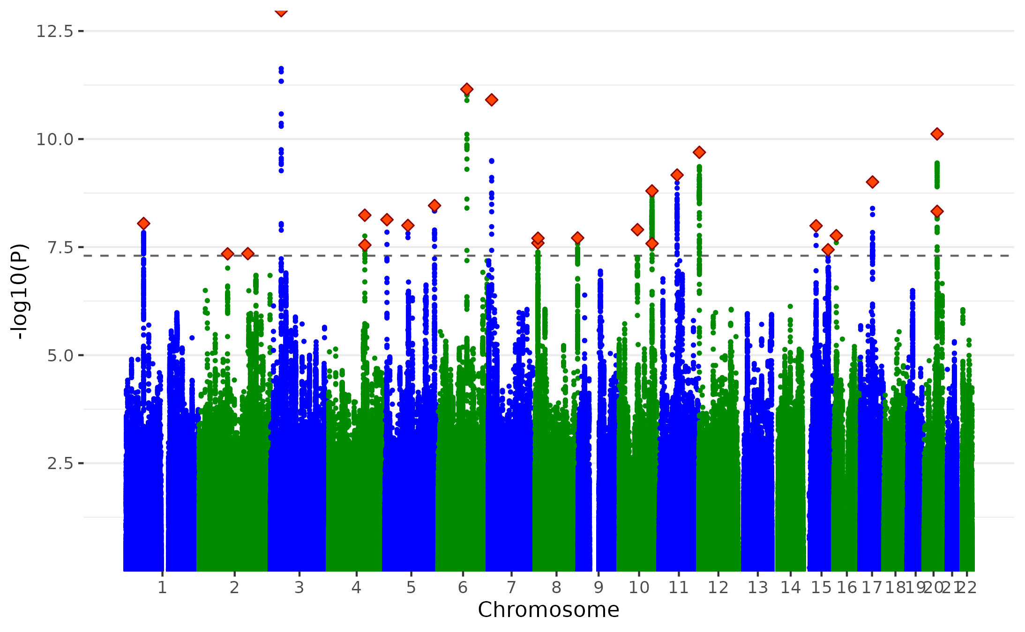
Comparing Bipolar Non-P with Bipolar original GWAS
Mullins et al., 2021

Slide 45
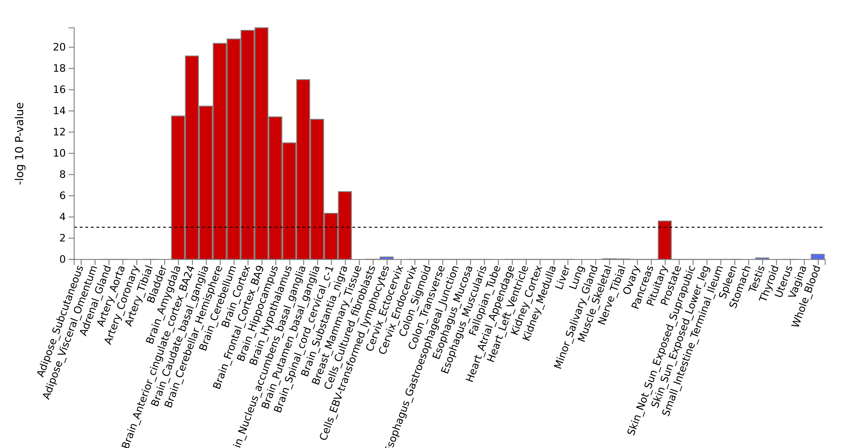
Bipolar Tissue Type Enrichment
Mapped Genes
659
137
28
83
6
3
GTEx v8 53 Tissue Types

